Slide 1
Review of Quiz 1 (CS 601) Chapters 1, 2 March 02, 2021 (during class hours) (1.15 pm to 3 pm) [You are allowed to carry one A4 sheet (both sides) material as reference]
Instructor: Dr. Vidhyacharan Bhaskar

Slide 2
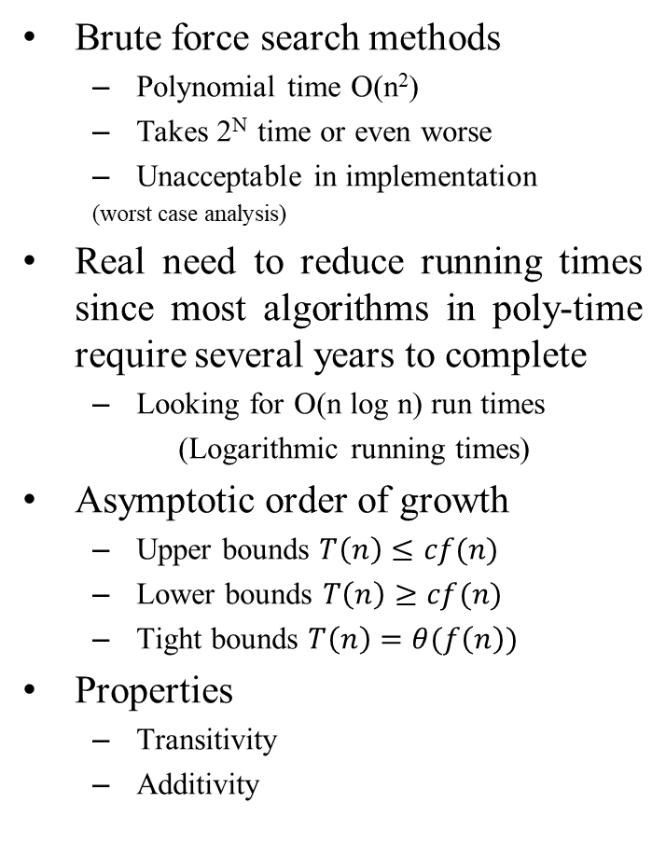
Chapter 1 (Algorithm Analysis)
Brute force search methods
Polynomial time O(n²)
Takes 2^{N} time or even worse
Unacceptable in implementation
(worst case analysis)
Real need to reduce running times since most algorithms in poly-time require several years to complete
Looking for O(n log n) run times
(Logarithmic running times)
Asymptotic order of growth
Upper bounds $T\left(n\right)≤cf(n)$
Lower bounds $T\left(n\right)≥cf(n)$
Tight bounds $T\left(n\right)=θ(f\left(n\right))$
Properties
Transitivity
Additivity
Examples of linear run times
Find maximum, minimum of a set of numbers
Examples of Logarithmic run times
Merge sort
Heap sort
Examples of quadratic run times
Find distance between all pairs of points in 2D space
Examples of cubic run times
For each pair of sets, determine if they are disjoint
Examples of polynomial times
Given a graph, are there k nodes such that no two are joined by an edge?
Examples of exponential run times
Given a graph, what is the maximum size of an independent set?

Slide 3
Chapter 2 (Graphs)
Undirected graph
No arrows on edges
Graph applications
Transportation
Communication
Networking (9-11 terrorist network)
WWW (Eg. Hyperlink from one page to another)
Social media (Eg., Terrorist networks)
Software systems
Scheduling
circuits
Graph representations
Adjacency matrix, adjacency list
Paths, nodes, edges, vertices, connectivity
A cycle is a path of k nodes where the first (k – 1) nodes are distinct
Tree is an undirected graph that is connected and does not contain a cycle
Root node
Parent node
Child nodes
Leaf nodes
Phylogeny trees
Describes evolution of a species
Trees
Shortest path problem between nodes s and t
Are nodes s and t connected (connectivity problem) ?
Breadth-first search trees – exhaustive search through all child nodes
Depth first search – search down the nodes till the leaf node appears
Bipartite graph – if every edge has one blue node and one red node

Slide 4
Chapter 2 (Graphs) and Chapter 3 (Greedy algorithms)
Bipartiteness
Matching input with the output
Does not contain an odd-length cycle
For layered bipartite graphs, no edge joins nodes belonging to the same layer
Directed graph
Edge (u, v) goes from node u to node v
Dendrograms
Strong connectivity
Nodes u and v are mutually reachable if there is a path from u to v and vice versa
Extending to all nodes in a graph, a graph can also be strongly connected
Directed acyclic graph (DAG)
A DAG is a directed graph that contains no directed cycles
Precedence constraint
Edge (u, v) means task u must occur before task v
Chapter 3 (Greedy algorithms)
Minimum spanning tree (MST)
Definition – subset of edges T contained in E such that T is a spanning tree whose sum of edge weights is minimized
Cayley’s theorem – there are n^{n-2} spanning trees in a graph
Applications of minimum spanning tree
Telephone, TV, and network cables
Travelling salesman problem
Types of Greedy algorithms
Kruskal’s algorithm
Prim’s algorithm
Reverse delete algorithm
Properties
Cut (minimum cost edge has one end-point in S)
Cyclic (maximum cost edge does not belong to the MST)
Clustering of maximum spacing
K-clustering (object divided into k groups)

Slide 5
Chapter 4 (Huffman codes)
Data compression
Encode text into symbols
Observe frequency of occurrence of a bit pattern
Compress that stream of bits into 1) nature of bit and 2) number of occurrences of the same bit
Prefix codes
No codeword is a prefix of another codeword
Represent prefix codes using binary trees
Compute symbol from bit pattern using the binary tree and vice versa
Optimal prefix codes
Average bits per letter is the sum over all symbols of its frequency times the number of bits of its encoding
Letters replaced with high frequency at the top
Huffman codes
Lowest frequency items should be at the lowest level in the tree of optimal prefix code
For n > 1, lowest level contains at least two leaves
Lowest frequency items have higher codeword length than highest frequency items
Time complexity: T(n) = O(n) + O(n – 1)
Achieves minimum ABL of any prefix code
Instructions for Quiz preparation:
Review homework problems 1 and 2
Solve problems similar to homework problems 1 and 2 at the end of the concerned Chapters and/or books/web material to get sufficient practice.
Prepare one A4 sheet (both sides) by writing or typing formulas, algorithms, equations, rules, pseudo codes, etc
Calculators are permitted, and not any other electronic gadgets.

